Slide 1
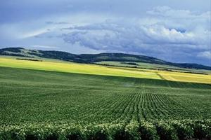
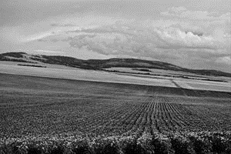
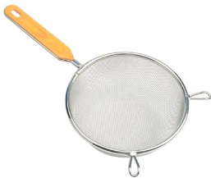
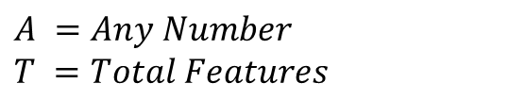
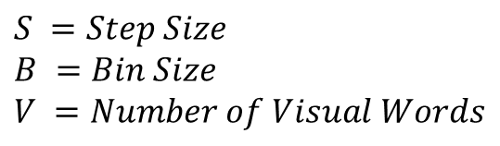
Build Vocabulary
$$S =Step Size$$
$$B =Bin Size$$
$$V =Number of Visual Words$$
$$A =Any Number$$
$$T =Total Features$$
For each image
UINT8
SINGLE
Concatenate
Features
[128 x T]
K-Means Clustering
vl_kmeans(Features, V)
SIFT
vl_dsift(image, ‘fast’, ‘step’, S, ‘size’, B)
Cluster Centers
[128 x V]
SIFT Features
[128 x A]
Visual Words
[V x 128]

Slide 2
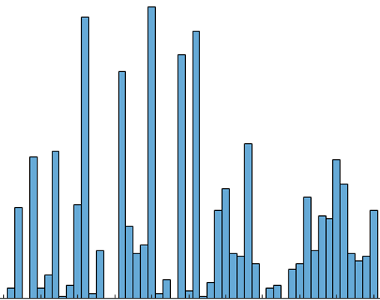
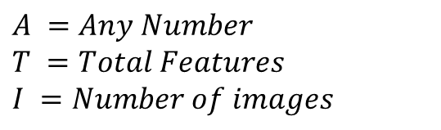
Bags of SIFTs
$$S =Step Size$$
$$B =Bin Size$$
$$V =Number of Visual Words$$
$$A =Any Number$$
$$T =Total Features$$
$$I =Number of images$$
For each image
UINT8
SINGLE
Calculate Euclidean distance
vl_alldist2(SIFT Features, Visual Words)
Histogram
[1 x V]
Distances
[A x V]
Get index of smallest value in each feature
Dense SIFT
vl_dsift(image, ‘fast’, ‘step’, S, ‘size’, B)
Indexes
[A x 1]
Normalise histogram
SIFT Features
[128 x A]
Features
[I x V]

Slide 3
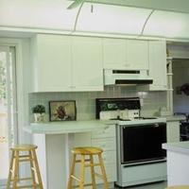
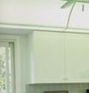

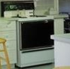

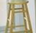

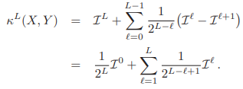
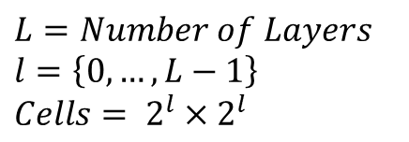
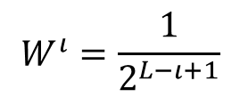
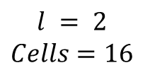
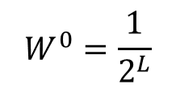
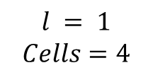
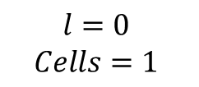
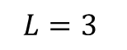
Spatial Pyramid
$$L=Number of Layers$$
$$l=\left\{0, …,L−1\right\}$$
$$Cells= 2^{l}×2^{l}$$
$$l=0$$
$$Cells=1$$
$$l = 1$$
$$Cells=4$$
$$l = 2$$
$$Cells=16$$
$$L=3$$
Calculate the weights of each layer
$$W^{0}=\frac{1}{2^{L}}$$
Adding weights to kernel layers increases the accuracy by about 5%
$$W^{ι}=\frac{1}{2^{L−ι+1}}$$

Slide 4
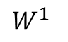
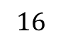
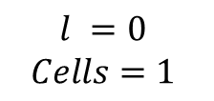
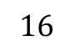
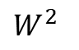
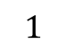
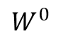
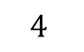
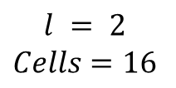
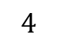
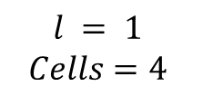
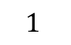
Spatial Pyramid
Total Features
$$l =0$$
$$Cells=1$$
$$1$$
Visual Words
$$1$$
$$W^{0}$$
$$4$$
SIFT
Distance
Histogram
Features
$$l = 1$$
$$Cells=4$$
For each cell (Bag of SIFTs)
.
.
.
.
.
Visual Words
$$4$$
$$W^{1}$$
SIFT
Distance
Histogram
Features
$$16$$
$$l = 2$$
$$Cells=16$$
For each cell (Bag of SIFTs)
Visual Words
$$16$$
$$W^{2}$$
SIFT
Distance
Histogram
Features

Slide 5
RGB SIFTs (Method 1)
$$S =Step Size$$
$$B =Bin Size$$
$$V =Number of Visual Words$$
$$A =Any Number$$
$$T =Total Features$$
[128 x A]
SIFT
Image R vector
Total SIFT Features
[384 x A]
[128 x A]
SIFT
Image G vector
[128 x A]
SIFT
Image B vector

Slide 6
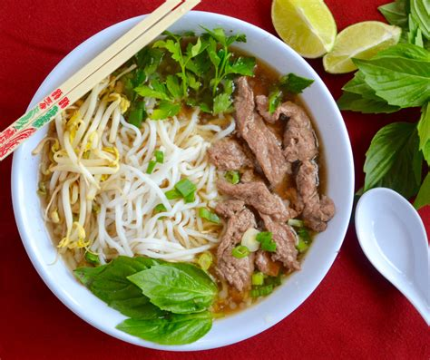
RGB SIFTs (Method 2)
$$S =Step Size$$
$$B =Bin Size$$
$$V =Number of Visual Words$$
$$A =Any Number$$
$$T =Total Features$$
W
Dense SIFT
vl_dsift(image, ‘fast’, ‘step’, S, ‘size’, B)
Pyramid Histogram Of Words (PHOW)
vl_phow(image, ‘step’, S, ‘sizes’, B)

Slide 7

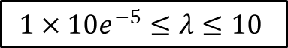
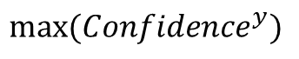
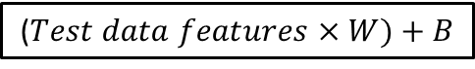
Support Vector Machine (SVM)
R
G
R
R
G
B
B
G
Unique labels
Train data labels
For each label
R
1
$$1×10e^{−5}≤λ≤10$$
G
R
-1
R
1
SVM
$$W,B$$
($Test data features×W)+B$
B
-1
G
-1
Train data features
Matching Indices
Prediction
N = Number of Test Data
C = Number of Classes
Confidence
[N x C]
$$max⁡({Confidence}^{y})$$

Slide 8
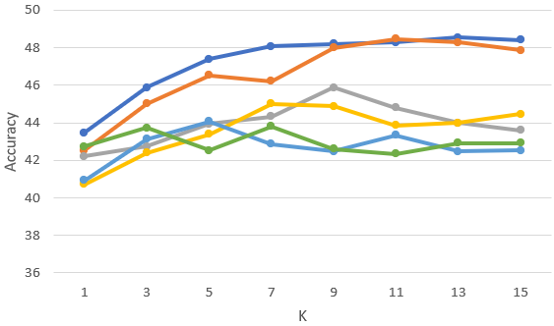
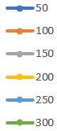
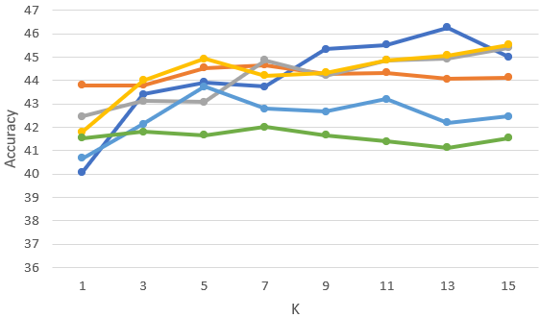
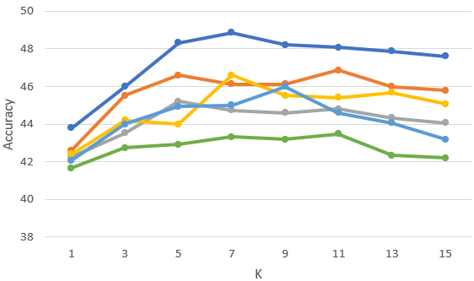
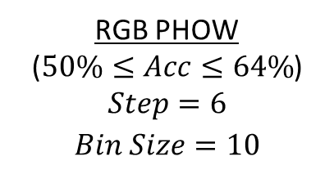
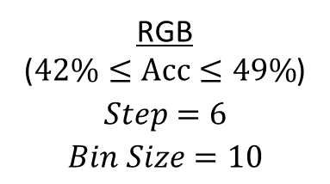
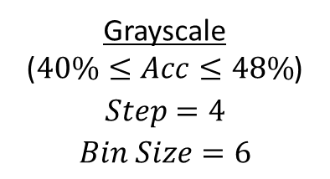
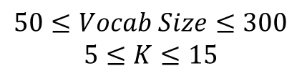
Results (Bags of SIFTs + KNN)
$$50≤Vocab Size≤300$$
$$5≤K≤15$$
Grayscale
($40\%≤Acc≤48\%$)
$$Step =4$$
$$Bin Size =6$$
RGB PHOW
($50\%≤Acc≤64\%$)
$$Step=6$$
$$Bin Size =10$$
RGB
($42\%≤Acc≤49\%$)
$$Step =6$$
$$Bin Size =10$$

Slide 9
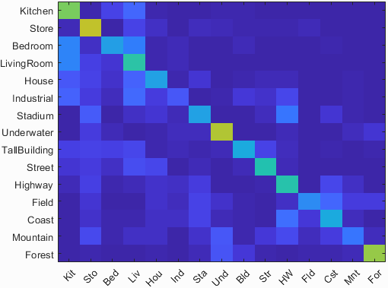
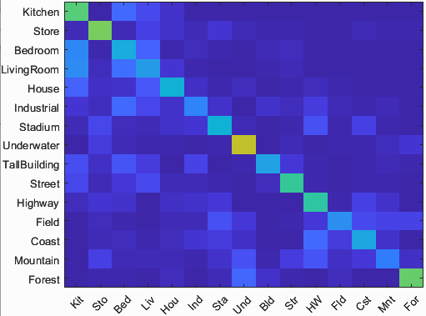
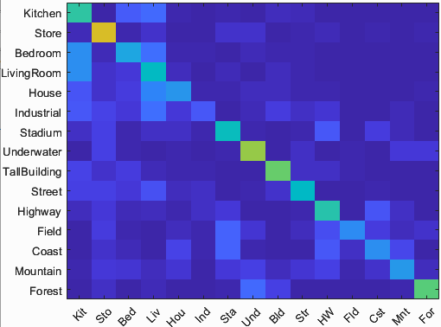
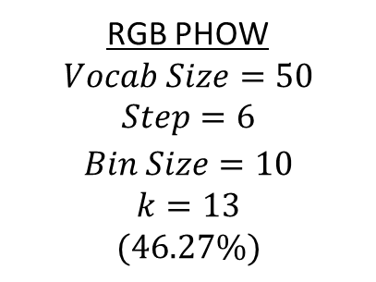
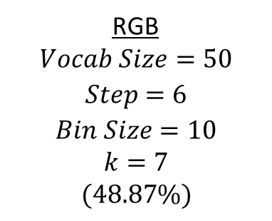
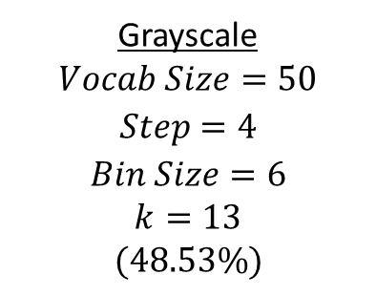
Best Results (Bags of SIFTs + KNN)
Grayscale
$$Vocab Size=50$$
$$Step =4$$
$$Bin Size =6$$
$$k=13$$
$$(48.53\%)$$
RGB
$$Vocab Size=50$$
$$Step =6$$
$$Bin Size =10$$
$$k=7$$
$$(48.87\%)$$
RGB PHOW
$$Vocab Size=50$$
$$Step=6$$
$$Bin Size =10$$
$$k=13$$
$$(46.27\%)$$

Slide 10
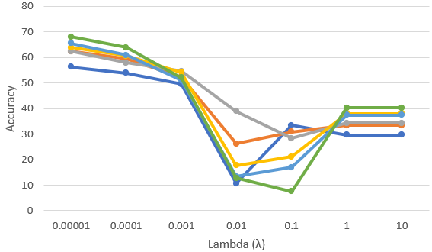






Results (Bags of SIFTs + SVM)
$$50≤Vocab Size≤300$$
$$0.00001≤Lambda \left(λ\right)≤10$$
Grayscale
($10\%≤Acc≤68\%$)
$$Step =4$$
$$Bin Size =6$$
RGB PHOW
($50\%≤Acc≤64\%$)
$$Step=6$$
$$Bin Size =10$$
RGB
($14\%≤Acc≤68\%$)
$$Step =6$$
$$Bin Size =10$$

Slide 11






Best Results (Bags of SIFTs + SVM)
Grayscale
$$Vocab Size=300$$
$$Step =4$$
$$Bin Size =6$$
$$Lambda (λ)=0.00001$$
$$(68.07\%)$$
RGB
$$Vocab Size=300$$
$$Step =6$$
$$Bin Size =10$$
$$Lambda \left(λ\right)=0.00001$$
$$(68.07\%)$$
RGB PHOW
$$Vocab Size=300$$
$$Step=6$$
$$Bin Size =10$$
$$Lambda \left(λ\right)=0.00001$$
$$(63.73\%)$$

Slide 12







Results (Spatial Pyramid + KNN)
$$50≤Vocab Size≤300$$
$$Layers = 3$$
$$1≤K≤15$$
Grayscale
($41\%≤Acc≤50\%$)
$$Step :4$$
$$Bin Size :4$$
RGB PHOW
($38\%≤Acc≤49\%$)
$$Step=6$$
$$Bin Size =8$$
RGB
($38\%≤Acc≤49\%$)
$$Step =6$$
$$Bin Size =8$$

Slide 13






Best Results (Spatial Pyramid + KNN)
Grayscale
$$Vocab Size=50$$
$$Step =4$$
$$Bin Size =4$$
$$Layers=3$$
$$k=11$$
RGB
$$Vocab Size=50$$
$$Step =4$$
$$Bin Size =8$$
$$Layers=3$$
$$k=7$$
RGB PHOW
$$Vocab Size=50$$
$$Step=4$$
$$Bin Size =8$$
$$Layers=3$$
$$k=11$$

Slide 14







Results (Spatial Pyramid + SVM)
$$50≤Vocab Size≤300$$
$$Layers = 3$$
$$0.00001≤Lambda \left(λ\right)≤10$$
Grayscale
($45\%≤Acc≤71\%$)
$$Step :4$$
$$Bin Size :4$$
RGB PHOW
($50\%≤Acc≤71\%$)
$$Step=6$$
$$Bin Size =8$$
RGB
($55\%≤Acc≤73\%$)
$$Step =6$$
$$Bin Size =8$$

Slide 15






Best Results (Spatial Pyramid + SVM)
Grayscale
$$Vocab Size=300$$
$$Step =4$$
$$Bin Size =4$$
$$Layers=3$$
$$Lambda \left(λ\right)=0.00001$$
$$(71.27\%)$$
RGB
$$Vocab Size=300$$
$$Step =4$$
$$Bin Size =8$$
$$Layers=3$$
$$Lambda \left(λ\right)=0.00001$$
$$(71.53\%)$$
RGB PHOW
$$Vocab Size=50$$
$$Step=4$$
$$Bin Size =8$$
$$Layers=3$$
$$Lambda \left(λ\right)=0.00001$$
$$(70.70\%)$$

Slide 16




Effects of SVM Lambda (Bag of SIFTs)
Grayscale
$$Vocab Size=50$$
$$Step =4$$
$$Bin Size =6$$
$$Lambda (λ)=0.00001$$
$$(58\%)$$
Grayscale
$$Vocab Size=50$$
$$Step =4$$
$$Bin Size =6$$
$$Lambda (λ)=0.01$$
$$(23.2\%)$$

Slide 17



Effects of SVM Lambda (Bag of SIFTs)
Grayscale
$$Vocab Size=300$$
$$Step =4$$
$$Bin Size =6$$
$$Lambda (λ)=0.00001$$
$$(68.07\%)$$
Grayscale
$$Vocab Size=300$$
$$Step =4$$
$$Bin Size =6$$
$$Lambda (λ)=0.01$$
$$(6.93\%)$$

Slide 18




Effects of SVM Lambda (Spatial Pyramids)
Grayscale
$$Vocab Size=50$$
$$Step =4$$
$$Bin Size =4$$
$$Layers=3$$
$$Lambda \left(λ\right)=0.00001$$
$$(61.67\%)$$
Grayscale
$$Vocab Size=50$$
$$Step =4$$
$$Bin Size =4$$
$$Layers=3$$
$$Lambda \left(λ\right)=0.01$$
$$(44.2\%)$$

Slide 19



Effects of SVM Lambda (Spatial Pyramids)
Grayscale
$$Vocab Size=300$$
$$Step =4$$
$$Bin Size =4$$
$$Layers=3$$
$$Lambda \left(λ\right)=0.00001$$
$$(71.27\%)$$
Grayscale
$$Vocab Size=300$$
$$Step =4$$
$$Bin Size =4$$
$$Layers=3$$
$$Lambda \left(λ\right)=0.01$$
$$(68.2\%)$$

Slide 20

Convolutional Neural Network (CNN) | INTRODUCTION
Feature extraction
Input Layer
Hidden Layer
Input classification
Fully connected Layer
Output Layer

Slide 21

Convolutional Neural Network (CNN) | INTRODUCTION
Feature extraction
Input Layer
Hidden Layer
Input classification
Fully connected Layer
Output Layer

Slide 22

Convolutional Neural Network (CNN) | INTRODUCTION
Feature extraction
Input Layer
Hidden Layer
Input classification
Fully connected Layer
Output Layer

Slide 23

Convolutional Neural Network (CNN) | INTRODUCTION
Feature extraction
Input Layer
Hidden Layer
Input classification
Fully connected Layer
Output Layer

Slide 24

Convolutional Neural Network (CNN) | INTRODUCTION
Feature extraction
Input Layer
Hidden Layer
Input classification
Fully connected Layer
Output Layer

Slide 25

Convolutional Neural Network (CNN) | INTRODUCTION
Feature extraction
Input Layer
Hidden Layer
Convolution
Activation
Pooling
Input classification
Fully connected Layer
Output Layer

Slide 26


Convolutional Neural Network (CNN) | INTRODUCTION
Feature extraction
Input Layer
Hidden Layer
Convolution
Activation
Pooling
Input classification
Fully connected Layer
Output Layer

Slide 27

Convolutional Neural Network (CNN) | INTRODUCTION
Feature extraction
Input Layer
Hidden Layer
Convolution
Activation
Pooling
Input classification
Fully connected Layer
Output Layer

Slide 28

Convolutional Neural Network (CNN) | INTRODUCTION
Feature extraction
Input Layer
Hidden Layer
Input classification
Fully connected Layer
Output Layer

Slide 29

Convolutional Neural Network (CNN) | INTRODUCTION
Feature extraction
Input Layer
Hidden Layer
Input classification
Fully connected Layer
Output Layer

Slide 30

Convolutional Neural Network (CNN) | EXPERIMENT
Input Data Augmentation
Hidden Layer Composition
Hyperparameter Tunning

Slide 31

Convolutional Neural Network (CNN) | EXPERIMENT
Input Data Augmentation
Hidden Layer Composition
Hyperparameter Tunning

Slide 32
Convolutional Neural Network (CNN) | EXPERIMENT
Input Data Augmentation
Hidden Layer Composition
Hyperparameter Tunning
Train Folder 1500
Test Folder 1500
Combined 3000
Training 2400
Validation 300
Testing 300
15 Categories

Slide 33
Convolutional Neural Network (CNN) | EXPERIMENT
imds = imageDatastore(cat(1,imds1.Files,imds2.Files));
imds.Labels = cat(1,imds1.Labels,imds2.Labels);
[trainDataDS, rest] = splitEachLabel(imds, 0.8, 'randomized');
[validateDataDS, testDataDS] = splitEachLabel(rest, 0.5, 'randomized');
Input Data Augmentation
Hidden Layer Composition
Hyperparameter Tunning

Slide 34

Convolutional Neural Network (CNN) | EXPERIMENT
Input Data Augmentation
Rotation
Shearing
Translation
Reflection
Hidden Layer Composition
Hyperparameter Tunning

Slide 35
Convolutional Neural Network (CNN) | EXPERIMENT
imageAugmenter = imageDataAugmenter( ...
'RandRotation',[-20 20], ...
'RandXShear', [0 45], ...
'RandYShear', [0 45], ...
'RandXReflection', 1, ...
'RandYReflection', 1, ...
'RandXTranslation',[-3 3], ...
'RandYTranslation',[-3 3]);
trainData = augmentedImageDatastore(img_size, trainDataDS, 'DataAugmentation',imageAugmenter);
Input Data Augmentation
Rotation
Shearing
Translation
Reflection
Hidden Layer Composition
Hyperparameter Tunning

Slide 36

Convolutional Neural Network (CNN) | EXPERIMENT
Input Data Augmentation
Hidden Layer Composition
AlphaNet
7 hidden layers
5 convolution layers
2 fully connected layers
BetaNet
Hyperparameter Tunning

Slide 37

Convolutional Neural Network (CNN) | EXPERIMENT
Input Data Augmentation
Hidden Layer Composition
AlphaNet
BetaNet
8 hidden layers
5 convolution layers
3 fully connected layers
Hyperparameter Tunning

Slide 38
Convolutional Neural Network (CNN) | EXPERIMENT
Input Data Augmentation
Hidden Layer Composition
Hyperparameter Tunning
 | Exp 1 | Exp 2 | Exp 3
Optimizer | Adam* | Sgdm*
Epochs | 25 | 35 | 55
Batch size | 64 | 128 | 256
Learning rate | 0.01 | 0.05 | 0.001
adam - Adaptive Moment Estimation
sgdm - Stochastic Gradient Descent with Momentum

Slide 39


Convolutional Neural Network (CNN) | RESULTS
AlphaNet
Original data training
Augmented data training
BetaNet
Accuracy (mean of diagonal of confusion matrix) is 0.757

Slide 40


Convolutional Neural Network (CNN) | RESULTS
AlphaNet
Original data training
Feature map (1st convolution)
Feature map (5th convolution)
Augmented data training
BetaNet

Slide 41

Convolutional Neural Network (CNN) | RESULTS
AlphaNet
Original data training
Feature map (1st convolution)
Feature map (5th convolution)
Augmented data training
BetaNet

Slide 42


Convolutional Neural Network (CNN) | RESULTS
AlphaNet
Original data training
Augmented data training
BetaNet
Accuracy (mean of diagonal of confusion matrix) is 0.650

Slide 43

Convolutional Neural Network (CNN) | RESULTS
AlphaNet
Original data training
Augmented data training
Feature map (1st convolution)
Feature map (5th convolution)
BetaNet

Slide 44

Convolutional Neural Network (CNN) | RESULTS
AlphaNet
Original data training
Augmented data training
Feature map (1st convolution)
Feature map (5th convolution)
BetaNet

Slide 45


Convolutional Neural Network (CNN) | RESULTS
AlphaNet
BetaNet
Original data training
Augmented data training
Accuracy (mean of diagonal of confusion matrix) is 0.617

Slide 46

Convolutional Neural Network (CNN) | RESULTS
AlphaNet
BetaNet
Original data training
Feature map (1st convolution)
Feature map (5th convolution)
Augmented data training

Slide 47

Convolutional Neural Network (CNN) | RESULTS
AlphaNet
BetaNet
Original data training
Feature map (1st convolution)
Feature map (5th convolution)
Augmented data training

Slide 48


Convolutional Neural Network (CNN) | RESULTS
AlphaNet
BetaNet
Original data training
Augmented data training
Accuracy (mean of diagonal of confusion matrix) is 0.643

Slide 49

Convolutional Neural Network (CNN) | RESULTS
AlphaNet
BetaNet
Original data training
Augmented data training
Feature map (1st convolution)
Feature map (5th convolution)

Slide 50

Convolutional Neural Network (CNN) | RESULTS
AlphaNet
BetaNet
Original data training
Augmented data training
Feature map (1st convolution)
Feature map (5th convolution)

Slide 51
References
S. Lazebnik, C. Schmid and J. Ponce, "Beyond Bags of Features: Spatial Pyramid Matching for Recognizing Natural Scene Categories," 2006 IEEE Computer Society Conference on Computer Vision and Pattern Recognition (CVPR'06), New York, NY, USA, 2006, pp. 2169-2178, doi: 10.1109/CVPR.2006.68.
K. He, X. Zhang, S. Ren and J. Sun, "Spatial Pyramid Pooling in Deep Convolutional Networks for Visual Recognition," in IEEE Transactions on Pattern Analysis and Machine Intelligence, vol. 37, no. 9, pp. 1904-1916, 1 Sept. 2015, doi: 10.1109/TPAMI.2015.2389824.
K. Grauman and T. Darrell, "The pyramid match kernel: discriminative classification with sets of image features," Tenth IEEE International Conference on Computer Vision (ICCV'05) Volume 1, Beijing, China, 2005, pp. 1458-1465 Vol. 2, doi: 10.1109/ICCV.2005.239.
LeCun, Y., Bengio, Y. & Hinton, G. Deep learning. Nature 521, 436–444 (2015).
Krizhevsky, Alex, Ilya Sutskever, and Geoffrey E. Hinton. "Imagenet classification with deep convolutional neural networks." Communications of the ACM 60.6 (2017): 84-90.

Slide 52


Slide 53


